Slide 1
Digital Portfolio
STUDENT NAME: M.IYAPPAN
REGISTER NO AND NMID: 24131061802521025/E92061602ACF634864F496B22B994888
DEPARTMENT: Bsc.COMPUTER SCIENCE
COLLEGE: COLLEGE/ UNIVERSITY: SHREE RAGHAVENDRA ARTS AND SCIENCE COLLEGE KEEZHAMOONGILADI/ANNAMALAI UNIVERSITY

Slide 2
PROJECT TITLE :
PORTFOLIO WEB PAGE

Slide 3


AGENDA
Problem Statement
Project Overview
End Users
Tools and Technologies
Portfolio design and Layout
Features and Functionality
Results and Screenshots
Conclusion
Github Link
3/21/2024 Annual Review

Slide 4

PROBLEM STATEMENT
personal portfolio website that highlights skills, projects, and contact details in an interactive and professional way.

Slide 5

PROJECT OVERVIEW
The portfolio website is designed to showcase personal skills, projects, and contact details in a simple and professional format. Built with HTML, CSS, and JavaScript, it acts as a digital resume and enhances online presence.

Slide 6

WHO ARE THE END USERS?
Potential Employers/Recruiters
Clients
General Audience

Slide 7

TOOLS AND TECHNIQUES
* HTML 5
* CSS 3
* JAVASCRIPT
* VS Code
* browser developer tool

Slide 8
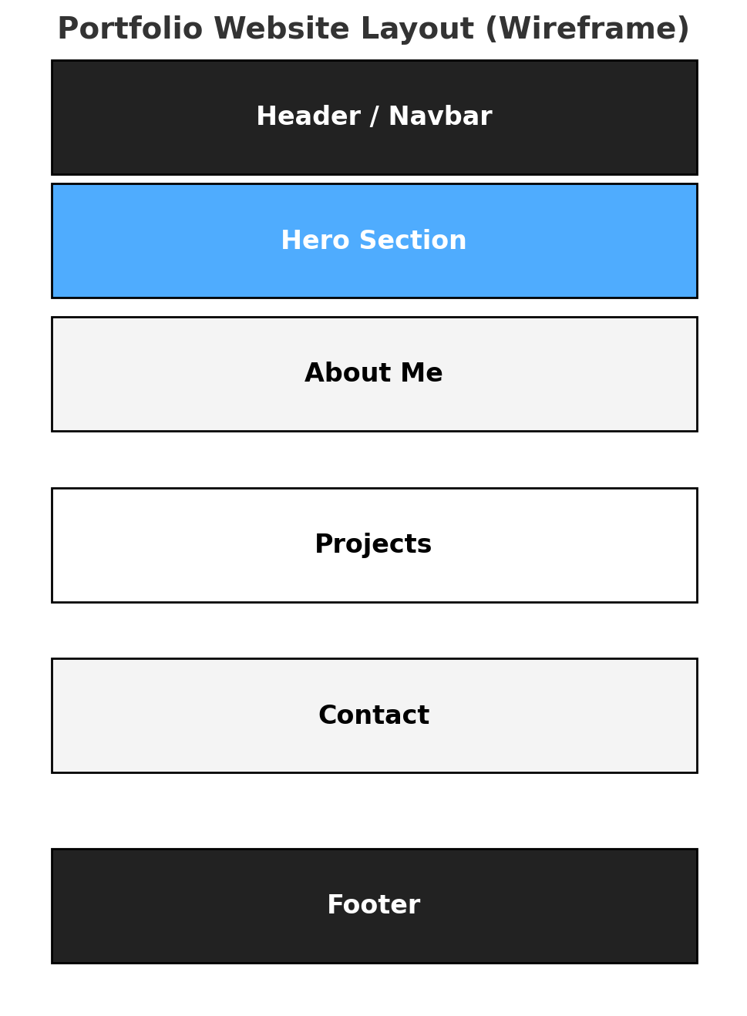
POTFOLIO DESIGN AND LAYOUT

Slide 9
FEATURES AND FUNCTIONALITY
Responsive Design – works smoothly across desktops, tablets, and mobile devices.
Navigation Bar – fixed menu with smooth scrolling to sections.
Hero Section – introduces the portfolio owner with a name, role, and call-to-action button.
About Section – provides a short bio, skills, and expertise.
Projects Section – showcases projects in a grid layout with images and descriptions.
Contact Form – allows visitors to send messages easily.
Interactive Elements – smooth scrolling, hover effects, and alerts for form submission.
Footer – includes copyright and additional details.

Slide 10
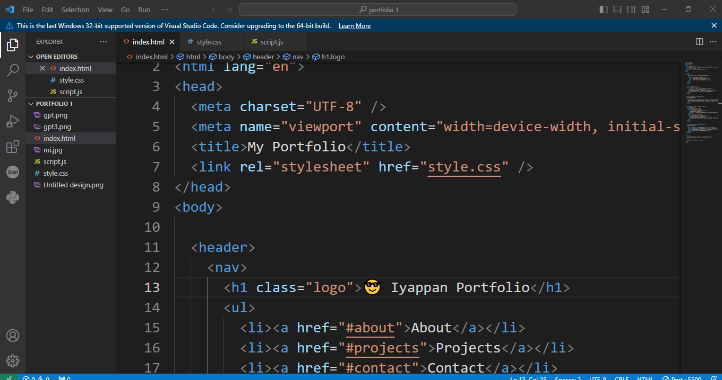
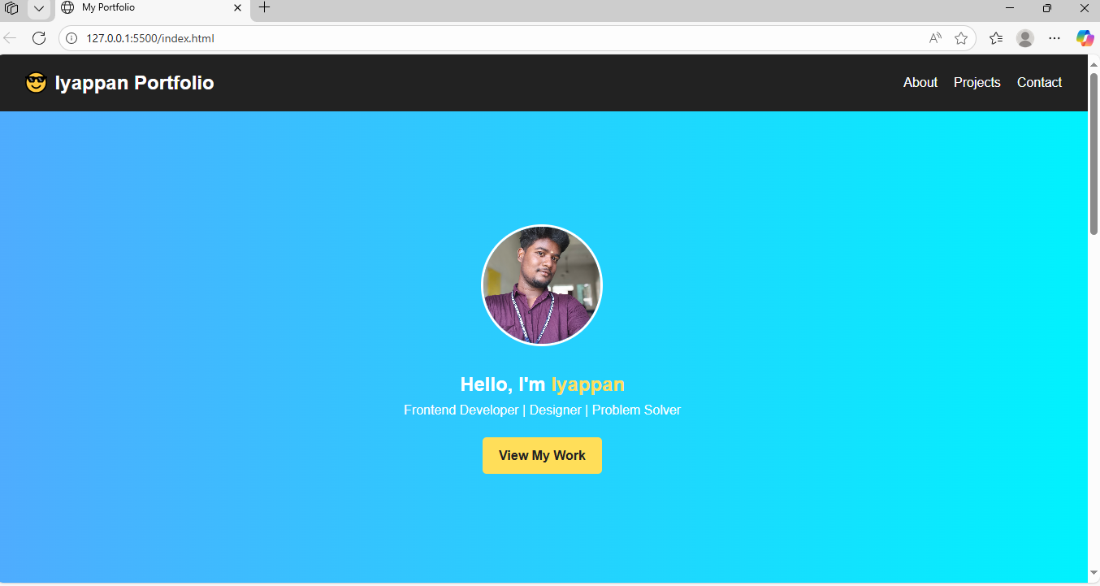

RESULTS AND SCREENSHOTS
RESULT
The portfolio website was successfully developed using HTML, CSS, and JavaScript.
SCREENSHOTS
3/21/2024 Annual Review

Slide 11
CONCLUSION
The portfolio website successfully demonstrates how a personal digital platform can enhance professional presence by showcasing skills, projects, and contact details in a structured and interactive manner. Built using HTML, CSS, and JavaScript, the site provides a responsive, user-friendly design with smooth navigation and essential features. This project not only serves as a digital resume but also strengthens opportunities for career growth, networking, and client engagement.

